Slide 1


Formally Verified Network Stack Synthesis for seL4
Eric Smith (speaker)
Alessandro Coglio
Kestrel Technology, LLC

Slide 2

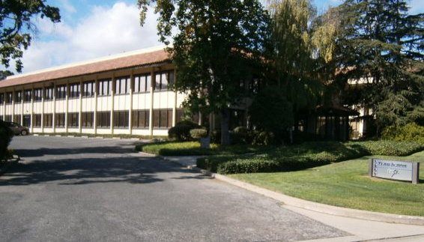
Who we Are: Kestrel Technology, LLC
Small business spun out of Kestrel Institute in 2000
Applied R&D firm with ambitions to make software safer
Formal network stack synthesis (this project)
CodeHawk static analyzer
  C, x86 binaries, Java
  Aims for completeness / soundness
  Now open source
Formal Unit Tester
  Supplement unit tests with small proofs about your code
x86 binary analysis
  Lift into logic for verification, matching, and analysis
Palo Alto, CA
http://kestreltechnology.com/

Slide 3
Background
The seL4 kernel has a very high level of assurance
But: It does not natively provide the typical POSIX interface that users expect of an operating system (files, processes, networking, etc.).
  Implementations exist but many are not yet formally verified

Slide 4
Project Overview
Goal: Synthesize a high-assurance TCP/IP implementation for seL4.
  Generate formally-verified C code
  Cover IP, TCP, UDP, etc.
  Make the generated code open source
  Use/extend Kestrel’s open source synthesis tools
Why start with a TCP/IP stack?
  Is needed by many applications
  Faces the external world and thus must safely process data from attackers
  May be used by multiple seL4 partitions and thus must keep their data strictly separate
Benefits:
  Will help others build secure systems on seL4
  Will help extend seL4's assurance case to larger systems based on seL4
  Code will be provably immune to various attacks (subject to assumptions)
Approach: Use ACL2 theorem prover and Kestrel’s APT toolkit

Slide 5
Project Status
Phase I (feasibility study) complete
  Initial experiments worked out
Phase II started in mid-September, 2020
  Initial version of C generator working
  Working on protocol specs and system architecture
  2 year project. Lots to do!

Slide 6
Software Synthesis and the APT Toolkit
Kestrel’s Automated Program Transformation Toolkit

Slide 7
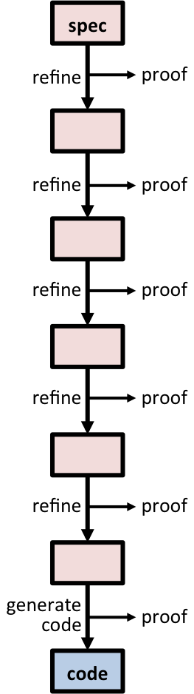
Software Synthesis for Formally Verified Code
Derive code from a specification
Step-by-step, via refinements, often performed by automated transformations
  Introduce data types/algorithms
  Introduce optimizations systematically
  Target code to a particular platform
  Obfuscate code, if desired
Last step generates code
Each step generates a proof
Chain together all proofs to obtain a proof that the code implements the spec
derivation

Slide 8
The Specification
Formalizes the requirements and assumptions
Is written in logic
Should be as clear and simple as possible
Should describe what the program should do but not how to do it
  Avoid specifying algorithms or internal data structures
  Don't include optimizations!
Best of both worlds:
  simple spec
  performant code
  proofs linking the two

Slide 9
The Derivation
Derivation = a sequence of refinements
Each refinement:
  Makes a single design choice
  May narrow down the space of possible implementations
  May be carried out by an automated transformation
  Can be selected from a library of refinements
  Is checked by the theorem prover
Advantages:
  Assurance (correct-by-construction)
  Automation
  Small, tractable proof steps
  Many steps and proofs done by the transformations
  Can re-derive implementations after the spec changes
derivation

Slide 10
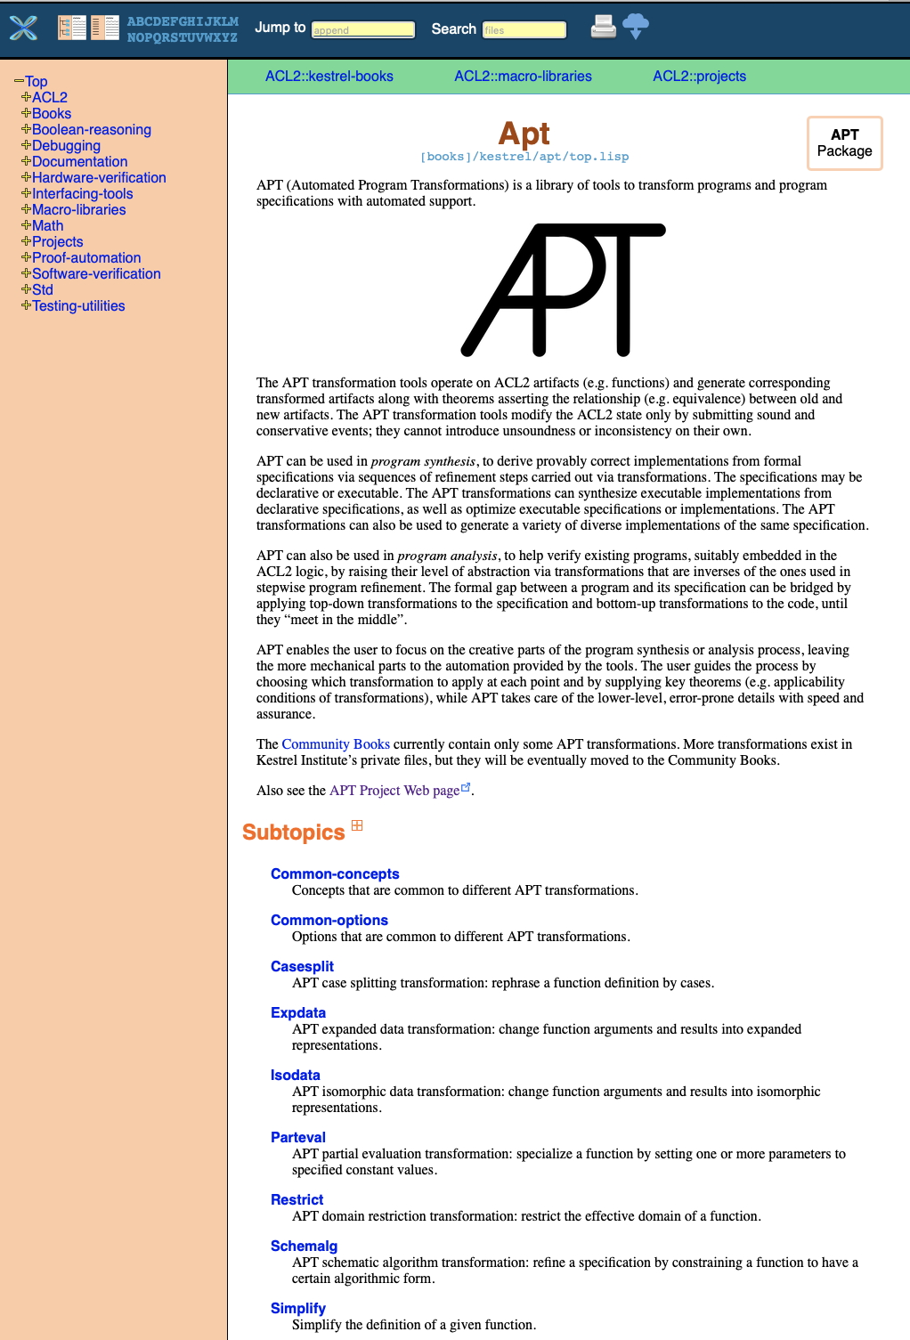
Kestrel’s APT Toolkit for
Program Synthesis
APT tool suite = “Automated Program Transformations”
Kestrel’s next-generation software synthesis system
Built on the ACL2 theorem prover (1989-present)
Has roots in Kestrel’s previous systems (Specware, KIDS, etc.) and work done at Stanford ca. 2005-2011
Open source project under active development since 2014 (sponsors include DARPA, AFRL)
Each synthesis step produces a proof checked by the prover
Partially (eventually all) open-source, at
https://github.com/acl2/acl2/tree/master/books/kestrel/apt

Slide 11












ACL2: Industrial-Strength Prover
APT is based on ACL2, an existing, industrial-strength theorem prover used by many companies
We are working with the main ACL2 developer

Slide 12
Example APT Transformations
Application of algorithm schemas
(e.g. divide & conquer)
Recursion-to-iteration
Finite differencing (a.k.a. incrementalization)
Data type refinement
Simplification/rewriting
Partial evaluation
Domain restriction
Predicate narrowing

Slide 13
Full List of APT Transformations
make-tail-rec
  assoc
  monoid
  nats counting down
  bit vectors counting down
  list builder (list-to-array)
finite-difference
remove-cdring
expand-lets
letify
simplify-body
simplify
  function
  second-order function
  quantified function
rewrite-body
drop-function-from-nest
drop-irrelevant-params
flatten-params
homogenize-tail-rec
flip-if
rename-params
reorder-params
restructure-elseif
make-do-while
lift-condition
weaken
strengthen
wrap-output
wrap-input
undo-finite-difference
undo-make-tail-rec
define-op
copy-spec
spec substitution
schematic algorithms
  decrease-and-conquer
  divide-and-conquer
predicate narrowing
isomorphic data transformation
expanded data transformation
extract output
restore multiple values
reverse-array-filler
replace-term
apply-rule
last-element-of-list
hoist-if
direct solution via inference
  rewriting
  SMT/SAT (in progress)

Slide 14
Examples of Code with Proven APT Derivations*
MAVLink CRC checksum
MAVLink message creation
MAVLink message parsing
HTTP message creation
HTTP message parsing
AES cipher
TEA cipher
RC6 cipher
Bresenham’s Algorithm
Bitcoin:
Base58 encoding/decoding,
SHA-256, RIPEMD-160
Bitcoin address-to-public-key
factorial
Fibonacci
sum of squares
insertion sort
membership
find index
max element
negate bytes
prime sieve
reverse array
Flex theorem prover / planner
Drone fleet planning
TCP / IP packet parsing
*Many of these start by lifting code into logic and use bottom-up steps as well as top-down steps ("analysis by synthesis")

Slide 15
Applying APT to Network Packet Processing
At the 2019 seL4 Summit, we presented work using APT to synthesize packet processing code for TCP and IP
  See: https://www.sel4-us.org/summit2019/presentations/11_1_SmithEric_Correct-By-ConstructionNetworkStackSynthesis.pptx
Started with a high-level, simple specification
  Packet layout specified declaratively
Automatically specialized it for a specific packet layout
Automatically synthesized low-level bit manipulation code (shifting, masking, etc)
Same derivation script worked for IP and TCP
Caveats: Not yet handling TCP/IP options, not yet going all the way to C

Slide 16
C Code Generation

Slide 17

Code Generation
Last step of a derivation
Changes the language from ACL2 to the target programming language
The proofs need a formal semantics of the programming language
We are developing a proof-generating C code generator for ACL2

Slide 18
ATC: Kestrel’s C Generator for ACL2
ATC = ‘ACL2 To C’
  Builds on Kestrel’s existing ATJ generator(ACL2 To Java)
Emphasis on
  Idiomatic C code
  Efficient C code
  Verified C code
Not aiming at translating arbitrary ACL2 code to C code
Instead:
  Provides ACL2 representations of C constructs
  Expects the user to use APT to target those representations
  Recognizes the ACL2 representations and translates them to the corresponding C constructs
  Simpler translation ➔ simpler proofs

Slide 19
Synergy between
APT and ATC
Use APT to refine spec to use exclusively the ACL2 representations of the C constructs
The lowest-level spec is “C written in ACL2”
Use ATC to translate the lowest-level spec to the corresponding C code
The translation and proof are thus relatively simple
lowest-
level
spec

Slide 20
A Simple Concrete Example of
“C Written in ACL2”...
ACL2 function definition
“domain” of
the function
ACL2 representation of
the signed int type
(defun |f| (|x| |y| |z|)
(declare (xargs :guard (and (c::sintp |x|)
(c::sintp |y|)
(c::sintp |z|)
...))) ; more restrictions
(c::sint-mul (c::sint-add |x| |y|)
(c::sint-sub |z| (c::sint-const 3))))
ACL2 representation of
signed int addition
ACL2 representation of
signed int multiplication
ACL2 representation of
signed int subtraction
ACL2 representation of
the C signed int constant 3
(*) ‘sint’ = signed int

Slide 21
... and Its Translation to C
(defun |f| (|x| |y| |z|)
(declare (xargs :guard (and (c::sintp |x|)
(c::sintp |y|)
(c::sintp |z|)
...))) ; more restrictions
(c::sint-mul (c::sint-add |x| |y|)
(c::sint-sub |z| (c::sint-const 3))))
ATC
note the clear
correspondence
int f(int x, int y, int z) {
return (x + y) * (z - 3);
}

Slide 22
ATC Status
We have a simple working, proof-producing C Generator for ACL2:
A formal model of the abstract syntax, static semantics, and dynamics of a simple subset of C.
A pretty printer for the ASTs.
A well-defined form for “C written in ACL2”.
A translator for “C written in ACL2” which generates:
  The C code in a .c file.
  An ACL2 proof that the C code is statically well-formed (i.e. it compiles).
  An ACL2 proof that the C code is functionally equivalent to the ACL2 code.
    Includes proof of no undefined behavior
ATC currently supports simple constructs (e.g., functions over ints). Adding support for more.
See https://github.com/acl2/acl2/tree/master/books/kestrel/c/atc

Slide 23
APT Transformations for refining specs toward C code
Simplification transformation
  A. Coglio & M. Kaufmann & E. Smith, “A Versatile, Sound Tool for Simplifying Definitions”, ACL2 Workshop 2017
Isomorphic data transformation
  A. Coglio & S. Westfold, “Isomorphic Data Type Transformations”, ACL2 Workshop 2020
We will add/extend transformations as needed.

Slide 24
Functionality to Synthesize
Packet parsing and serialization
The TCP state-machine
Buffer / queue management
Sequence numbers and re-transmitting lost packets
Flow control
Congestion control
Approach: Start with a minimal feature set and add features over time

Slide 25
Specifying Protocols
Specs come from RFCs (e.g., RFC 793 and its successors, for TCP)
  ASCII art packet layouts
  ASCII art state machines
  Sequence diagrams
  English text
  Pseudocode
We will formalize these, focusing on simplicity and clarity, not performance
Highest level specs may even be non-deterministic / non-executable

Slide 26
The spec for TCP parsing
Our approach:
Specify the packet layout declaratively.
And specify how to parse any packet, given its layout.
(defconst *tcp-desc*
'((:source-port 16)
(:destination-port 16)
(:sequence-number 32)
(:ack-number 32)
(:data-offset 4)
(:reserved 4)
(:cwr 1)
(:ece 1)
(:urg 1)
(:ack 1)
(:psh 1)
(:rst 1)
(:syn 1)
(:fin 1)
(:window-size 16)
(:checksum 16)
(:urgent-pointer 16)))
(defun parse-bits (desc bits)
(if (endp desc)
nil
(let* ((pair (first desc))
(name (first pair))
(size (second pair)))
(if (< (len bits) size)
:error
(let* ((bits-for-name (take size bits))
(val-for-name (packbv size 1 bits-for-name)))
(acons name
val-for-name
(parse-bits (rest desc) (nthcdr size bits))))))))
(defun parse-bytes (desc bytes)
(parse-bits desc (bytes-to-bits bytes)))
See the Demo in last year’s Summit slides for more information

Slide 27
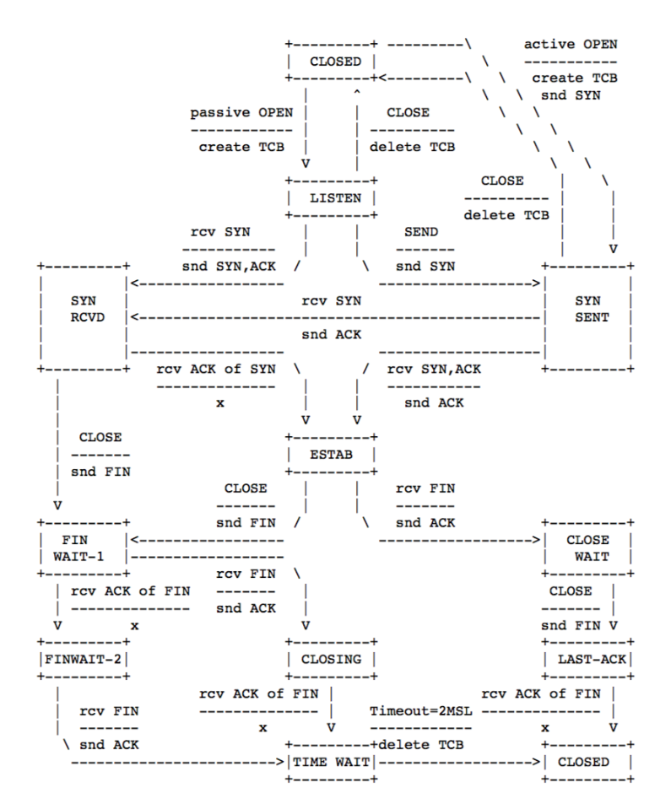
Specifying Protocol State Machines
Approach: Specify the state machine declaratively
Named states
  Can contain variables: Buffers, queues, socket info, etc. – represented as lists and maps
Transitions between states
  Have guards: Depend on inputs from the network or application
  Have actions: Send or receive data, update state variables
TCP/IP code
  Talks to the NIC to send and receive data
  Provides a POSIX socket interface to applications / higher-level protocols
Then: Refine the states, their variables, and their transitions to efficient imperative code.

Slide 28
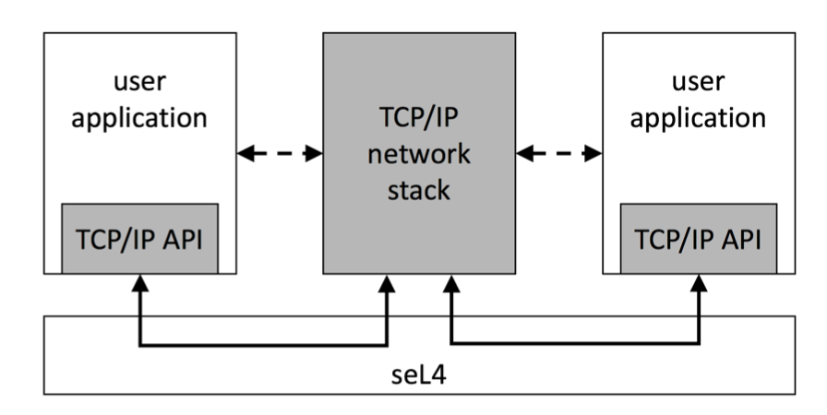
Planned System Architecture
Possible Architecture:
Network Stack in its own partition
NIC driver in the same partition, or in a separate partition
Synthesize code to help user applications access the network stack in a convenient POSIX-like way
Open questions:
  How dynamic is the configuration? All communication channels known beforehand?
  Integrate with CAmkES?
  Which NIC driver? Use a rump kernel?
Disclaimer: We are not yet seL4 experts! We welcome feedback on all this.
Please feel very free to get in touch if you want to use the network stack: eric.smith@kestreltechnology.com

Slide 29
Summary
Formally verified TCP/IP code for seL4 will support building secure, verified systems.
  May also help increase adoption of seL4.
The APT synthesis toolkit and the C language semantics will have independent value.
Thanks to our sponsors at DARPA and the Army!

Slide 30
Questions
“To submit questions, we are asking that you place them into the discussion board on the virtual hub page. You can also use this area to continue the discussion after the presentation as speakers will be checking for new comments throughout the summit.”

